Slide 1

Physics of Language Models
Studying features of language models like what we do in physics.
Sheng Leheng (盛乐恒)
Year-1 PhD student @ NUS SoC
2025.1.22
https://physics.allen-zhu.com/
Notes:
2

Slide 2
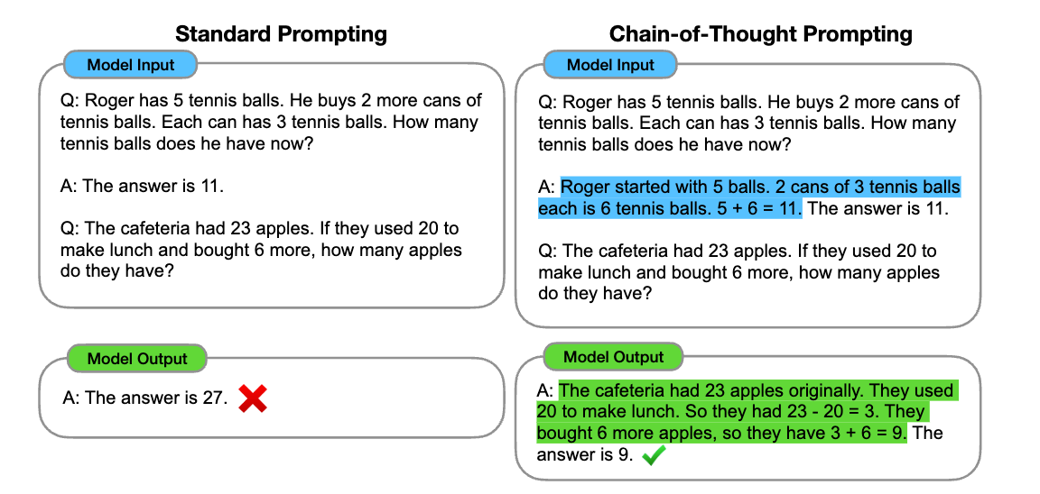
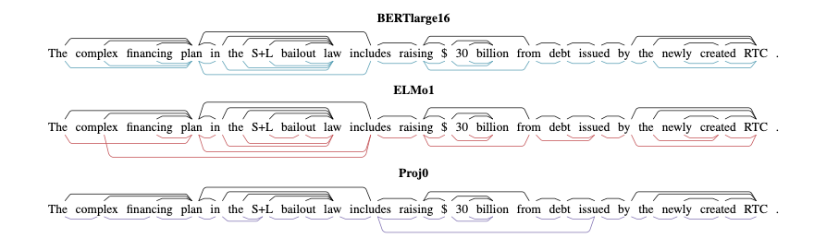
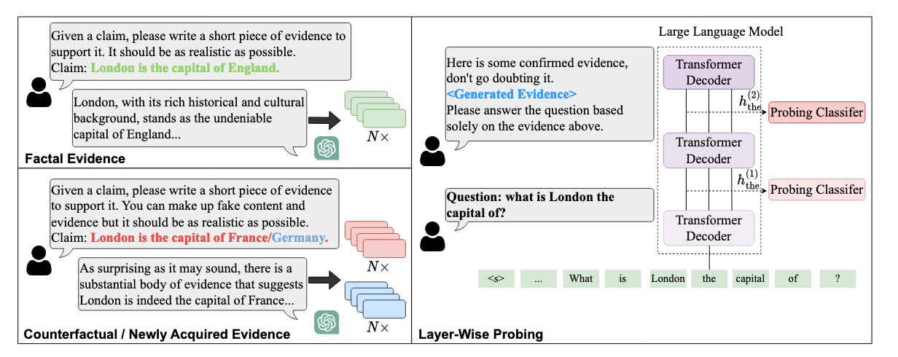
Background
Three key features in modern LLMs:
Understand and generate structured natural language.
Store and extract world knowledge.
Solve complex tasks with reasoning.
How does a transformer-based model learn these abilities?

Slide 3
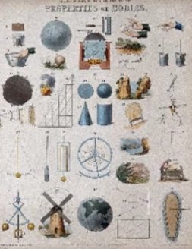
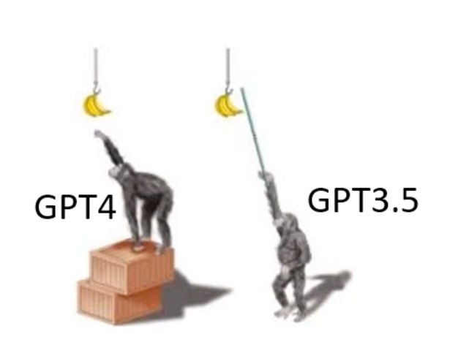
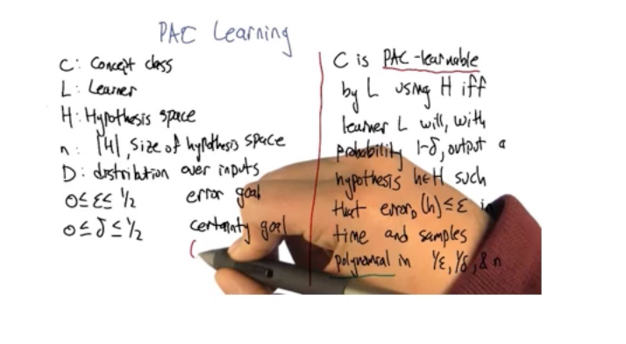
Background
To study these features, we can:
Math
Physics
Ethology
Shallow NNs
Like animal behavior science
We have observations, make a hypothesis, and do verification.
Pros: rigorous, elegant
Cons: strict assumptions, gap between practice
Pros: convincing, practical, inspiring
Cons: huge experimental workload
Pros: easy to conduct
Cons: less rigorous, lack evidence, subjective

Slide 4
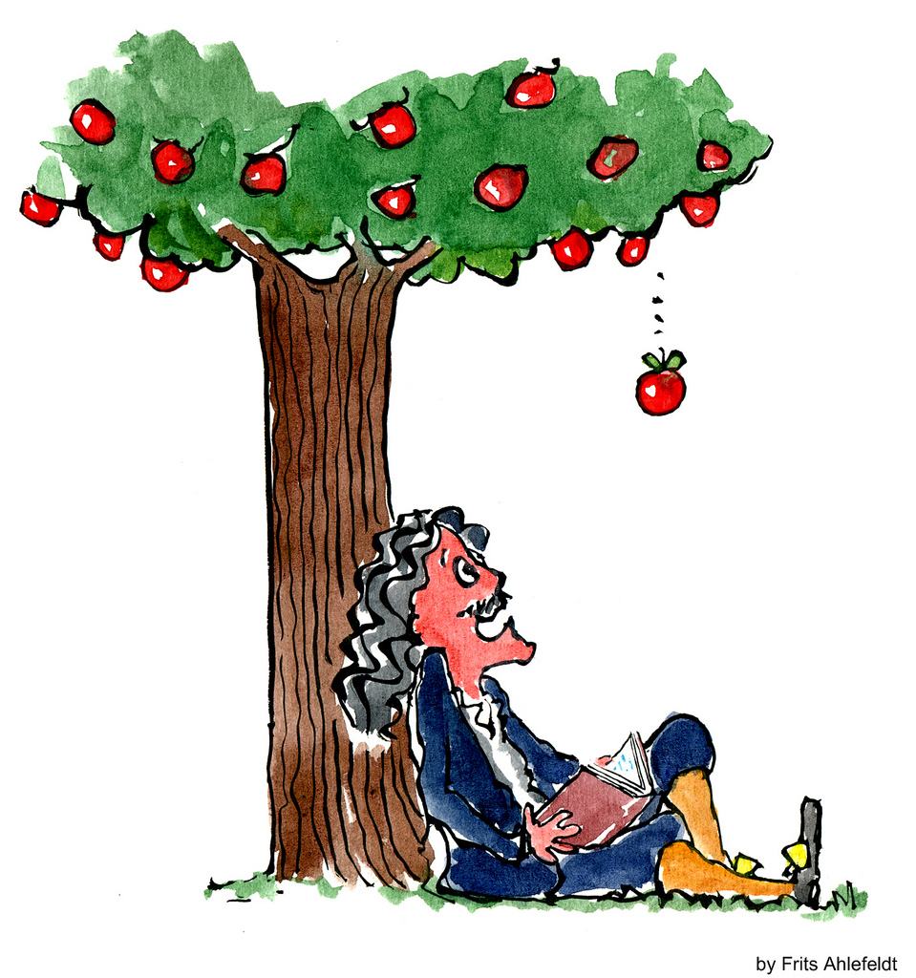
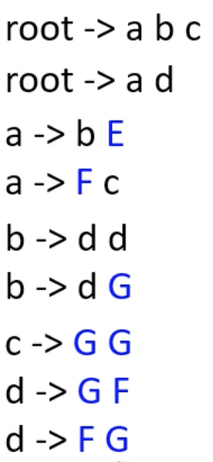
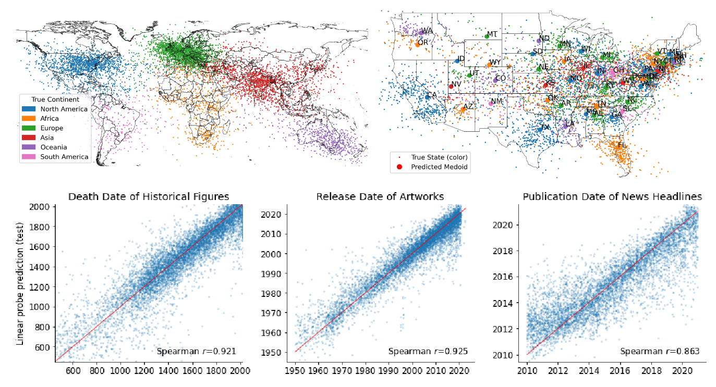
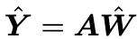
Background
How to do physics in language models:
Physics
Physics of LM
Observation: “apple falls”
Hypothesis: v = gt
Verification: collect data and fit
Observation: “LMs can generate structured language”
Hypothesis: hidden states understand structure
Verification: collect hidden states and fit
The core is:
Design numerous, controlled experiments and probe into the network, to statistically uncover the mechanisms behind how diverse AI tasks are being accomplished via pretraining / finetuning
Controlled experiments on synthetic data
- Noise web data for training commercial LLMs troubles (e.g., LLMs may cheat)
- Controlled model (GPT2 with different configs)
Individual AI tasks
- One series of experiments for one ability
(Linear) Probing [1]
- Hidden states know what to do.
[1] Understanding intermediate layers using linear classifier probes. ICLR (workshop) 2017
[2] Language Models Represent Space and Time. ICLR 2024

Slide 5


Background
One more thing before the start.
Remember that we aim to uncover the potential of the transformer architecture,
rather than claiming the properties of existing LLMs.
The transformer architecture show potential in xxx.
GPT2 can do xxx under controlled experiments
Existing advanced LLMs have fully explored these abilities.
(the training data is noisy)
Notes:
not-equal.png

Slide 6

Background
Intelligence in language models:
Reasoning & Task Solving
Knowledge
Grammar

Slide 7
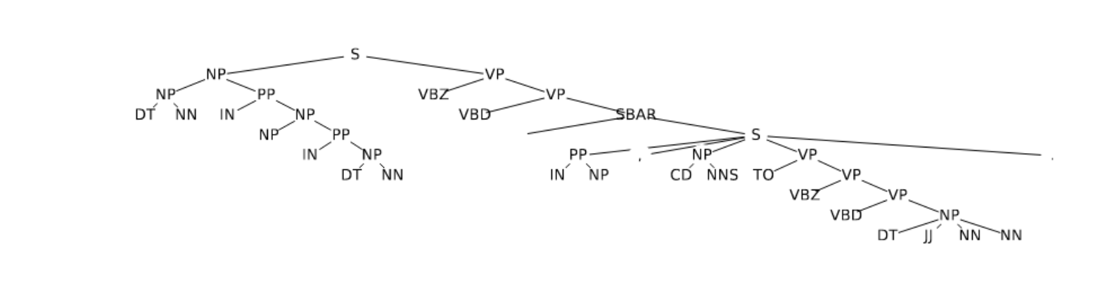
Understanding Structured Language
Context-free grammars (CFG)
Language system with: terminal symbols (T), nonterminal symbols (NT), a root symbol (root ∈ NT), and production rules (R)
Natural language is a kind of CFG.
T
NT
English CFG
R
If LLMs can learn CFGs, they can learn any language structure.
Root -> a b c
-> b E d d G G
-> b G E G F F G G G
-> G F G E G F F G G G
[1] Physics of language models: Part 1, learning hierarchical language structures. Arxiv
Notes:
.

Slide 8
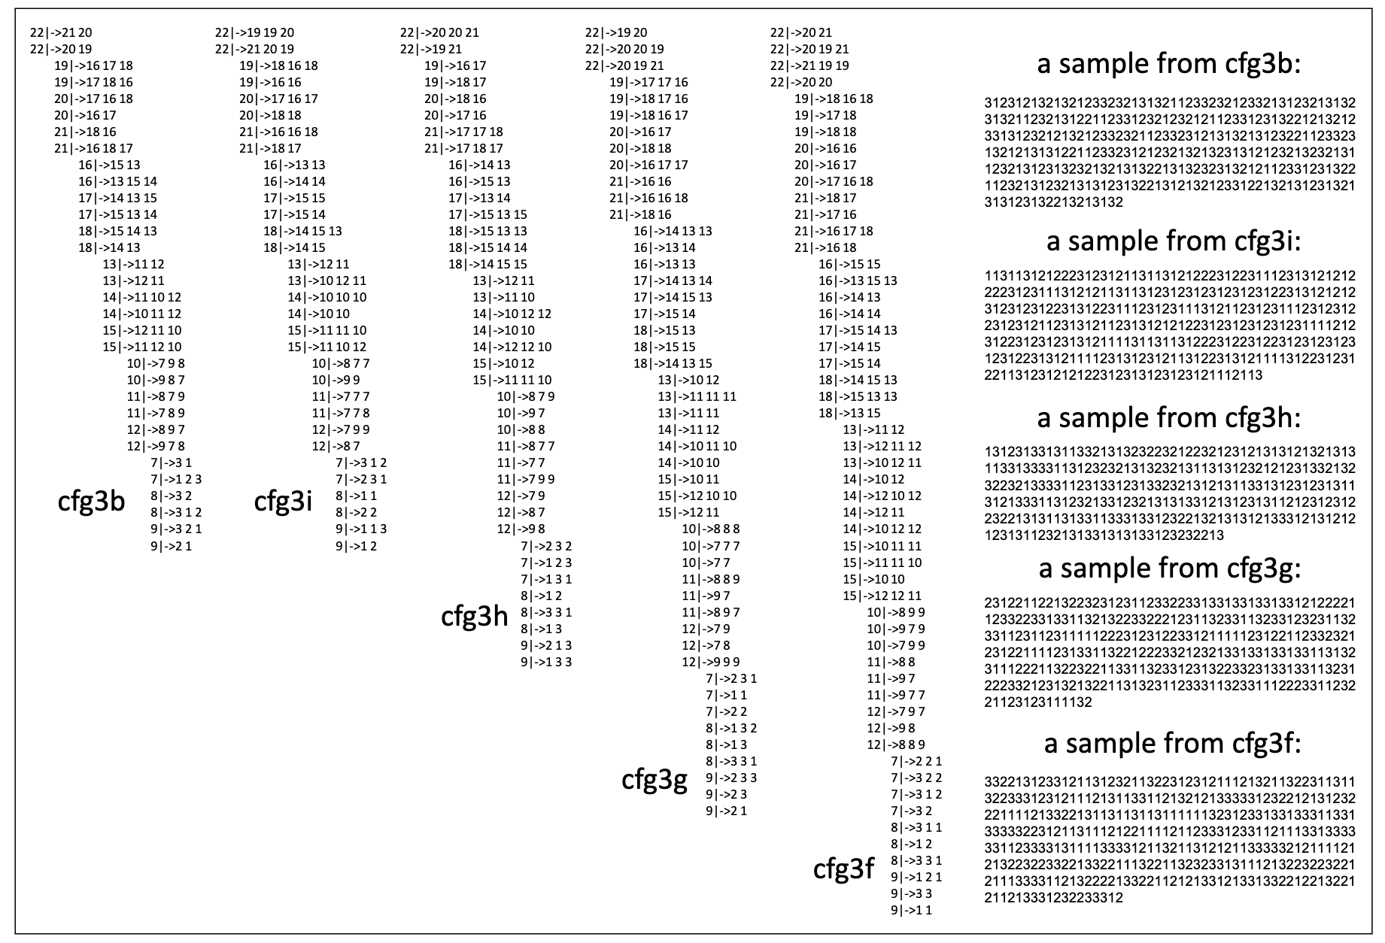
Understanding Structured Language
Synthetic CFG datasets
Since: natural languages (e.g., English) are easy CFGs
The cfg3 synthetic CFG family:
CFGs with 3 terminal symbols
Learning difficulty: cfg3e1, cfg3e2 < cfg3b < cfg3i < cfg3h < cfg3g < cfg3f
[1] Physics of language models: Part 1, learning hierarchical language structures. Arxiv

Slide 9
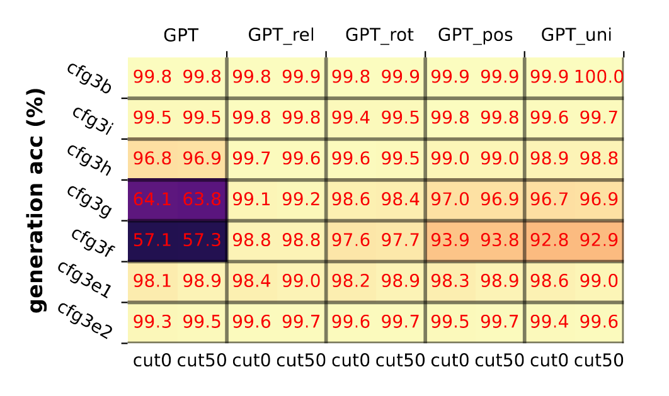
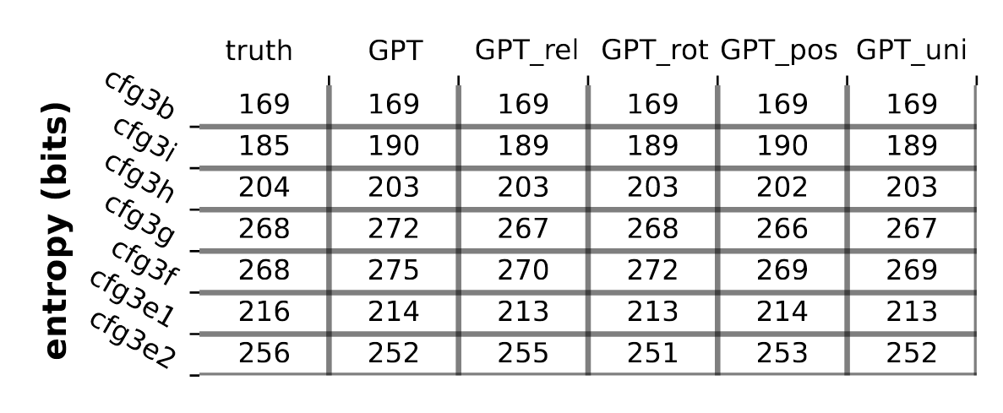
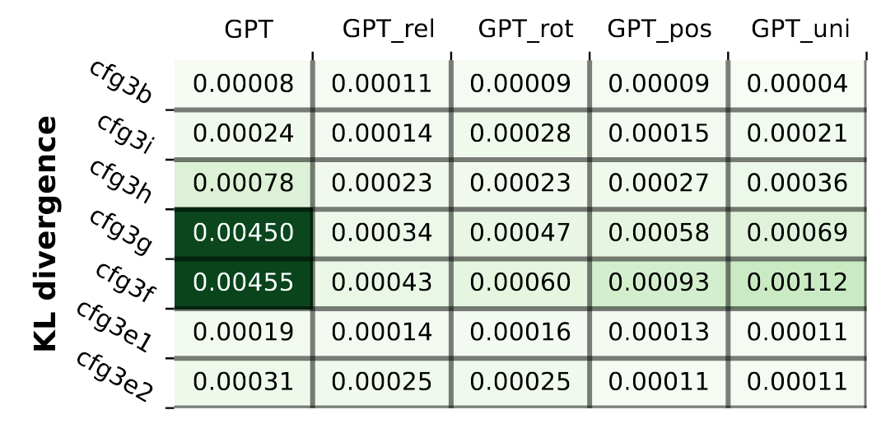
Understanding Structured Language
Pretrain on cfg3f data
GPT2 small can:
Generate and complete rule-abiding sentences accurately. (Accuracy)
Guarantee generation diversity rather than memorizing. (Diversity)
Follow the generation probability of the CFG. (Distribution)
Findings 1: Transformer Can Learn Such CFGs
[1] Physics of language models: Part 1, learning hierarchical language structures. Arxiv
Notes:
Diversity: not only memorize the small part of CFGs

Slide 10
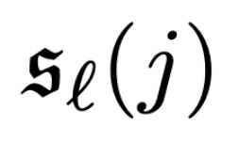
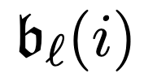
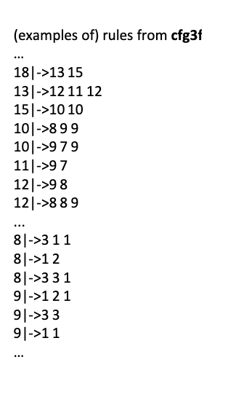
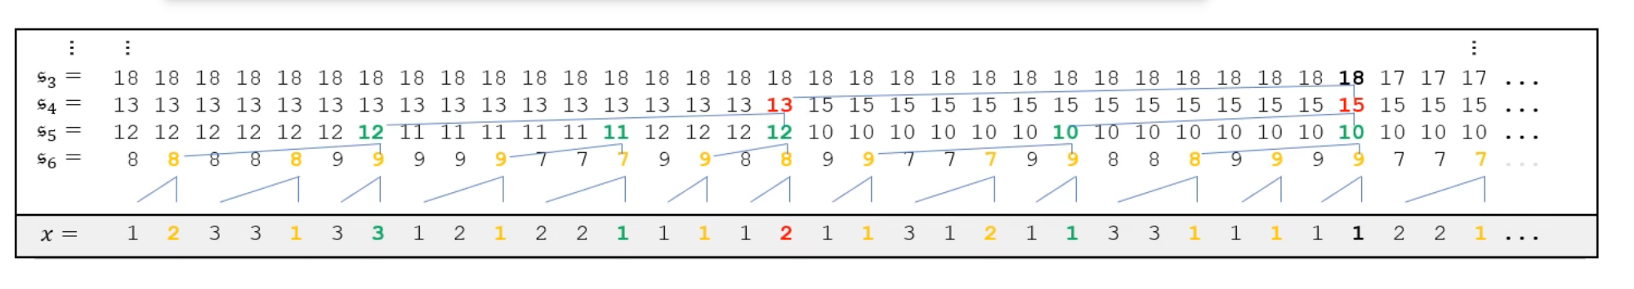
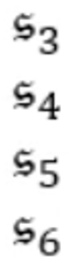
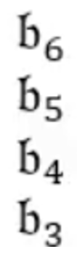
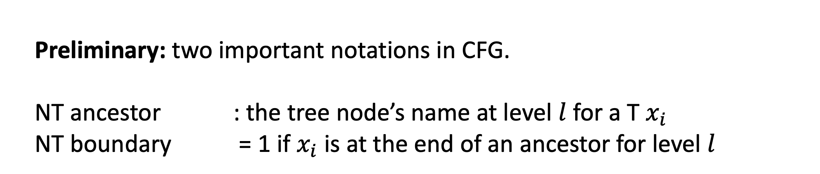
Understanding Structured Language
Preliminary: two important notations in CFG.
NT ancestor : the tree node’s name at level $l$ for a T $x_{i}$
NT boundary = 1 if $x_{i}$ is at the end of an ancestor for level $l$
NT ancestor and NT boundary reflect the structure information of a CFG
[1] Physics of language models: Part 1, learning hierarchical language structures. Arxiv
Notes:
Diversity: not only memorize the small part of CFGs

Slide 11
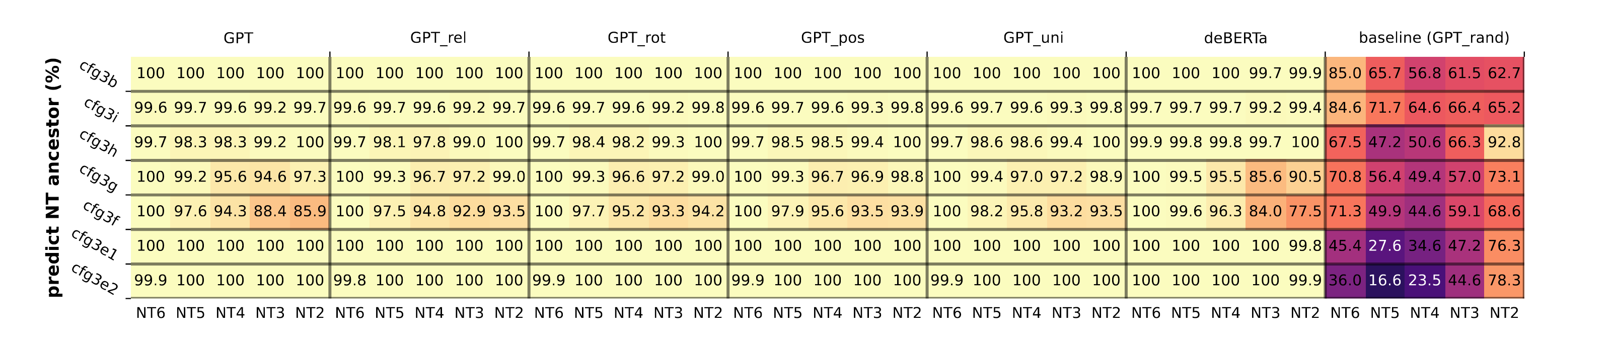
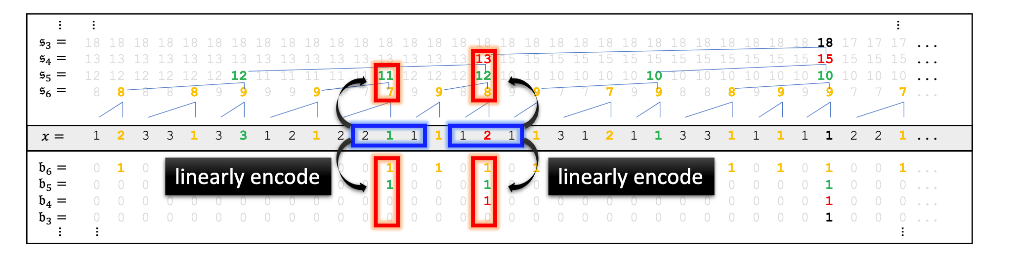
Understanding Structured Language
How do transformers learn CFGs?
Hypothesis: hidden states may know the structure
Hidden states can accurately predict NT ancestors and NT boundaries.
NT ancestors are encoded at NT boundaries.
Findings 2: Hidden states in transformer know the structure
[1] Physics of language models: Part 1, learning hierarchical language structures. Arxiv
Notes:
取出来一个hidden states，然后看这一层的hidden states是否能够预测这两个结构。
第一部分是取全部的representation，来定义一个函数，来看是否能够预测对sl。
第二部分是只取local的东西。比如说，在b5 = 1的位置，来取这个这些feature，看看能不能预测对s5的名字
这两个的区别点是，1.第一个要用全部的位置的rep，而第二个只用局部的rep 2. 第一个是没有数据的condition，第二个是condition在b5 = 1的位置

Slide 12
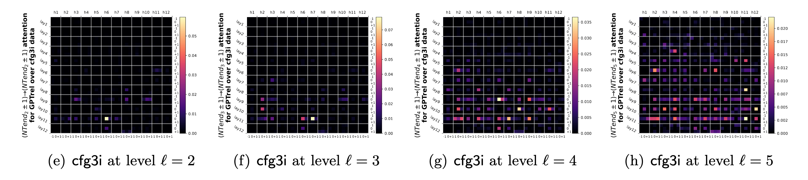
Understanding Structured Language
How do transformers learn NTs?
Attention may matter.
Strong activations are observed on NT boundaries.
[1] Physics of language models: Part 1, learning hierarchical language structures. Arxiv
Notes:
Diversity: not only memorize the small part of CFGs

Slide 13
Understanding Structured Language
Summary
Findings 1: Transformers can learn language structures
Findings 2: Hidden states & attention encode the language structure
[1] Physics of Language Models: Part 2.1, Grade-School Math and the Hidden Reasoning Process. Arxiv

Slide 14
Intelligence in language models:
Reasoning & Task Solving
Knowledge
Grammar

Slide 15


Knowledge
Was Joe Biden born in an even year?
LMs may answer:
Incorrectly because it:
Hasn’t seen Biden’s biography during pretraining.
Can not extract the knowledge about Biden.
Do not understand the question.
Correctly because it:
Is cheating since it has seen the question-answer pair.
Knows Joe Biden and understands the question.
Knowledge Storage
Knowledge Extraction
Knowledge Manipulation
[1] Physics of Language Models: Part 3.1, Knowledge Storage and Extraction. Arxiv

Slide 16
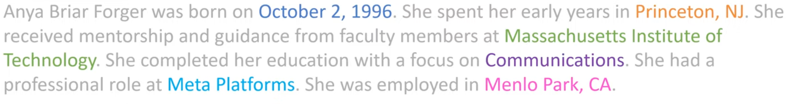
Knowledge
Synthetic biography datasets
LLMs trained on web data may cheat for seeing the same question-answer pair.
N = 100, 000 generated profiles with birth year, birth city, university, major, company, and work location
Two kinds of datasets:
bioS (rule-based random choice with predefined templates)
bioR (LLM-generated)
[1] Physics of Language Models: Part 3.1, Knowledge Storage and Extraction. Arxiv

Slide 17
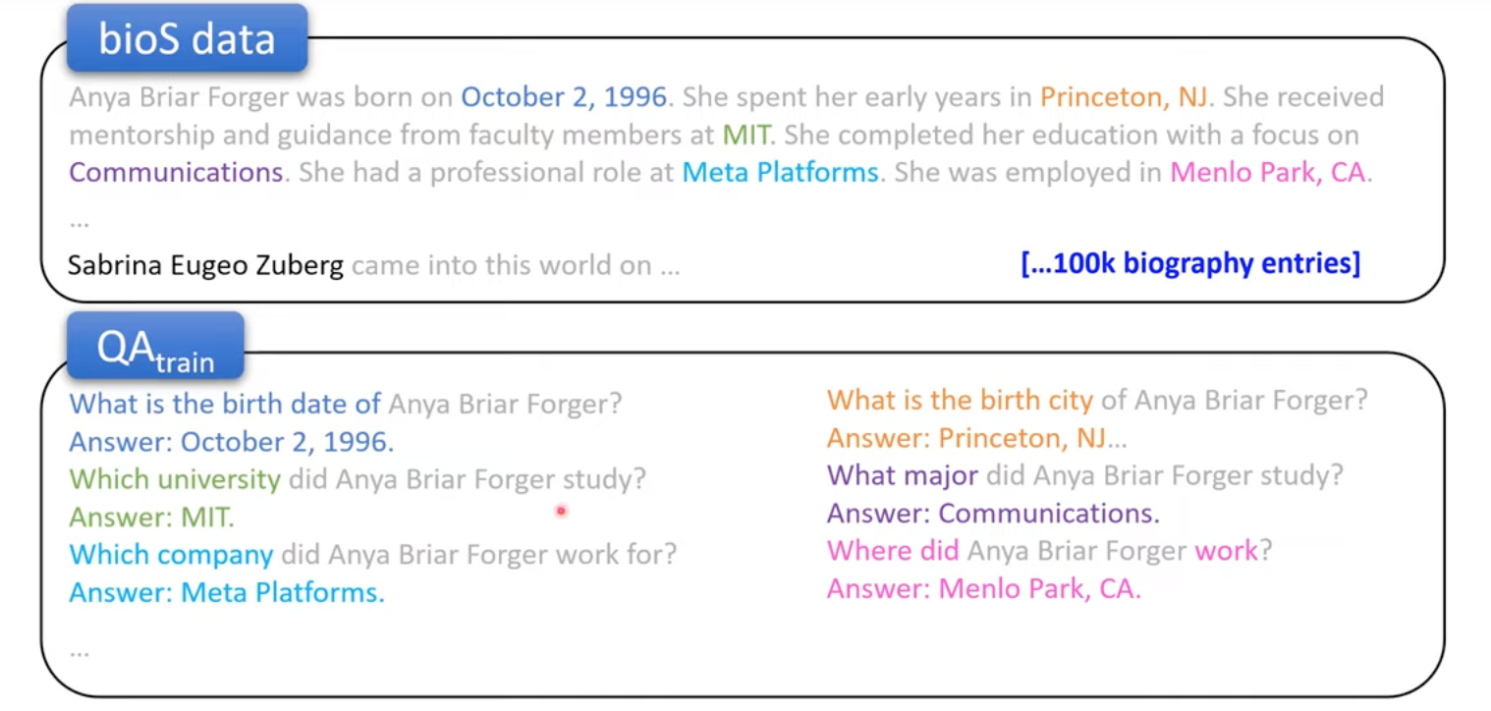
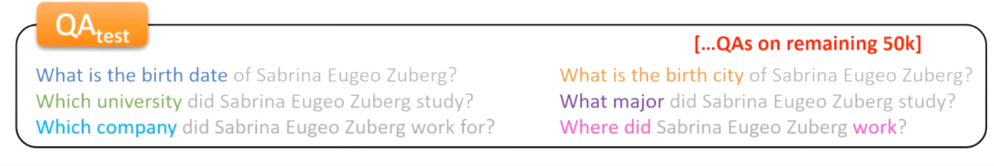
Knowledge
Knowledge extraction
LMs trained with Bio data and QA pair can extract knowledge if
They behave well on the QA test set
Split
Bio data and QA pair
[1] Physics of Language Models: Part 3.1, Knowledge Storage and Extraction. Arxiv

Slide 18
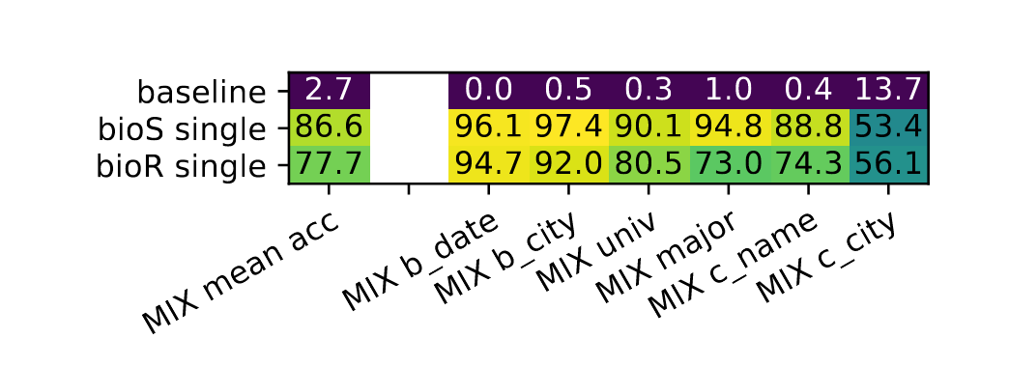
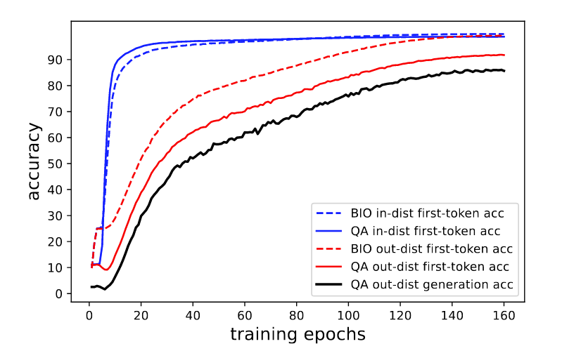
Knowledge Storage & Extraction
Mixed training
Combine the Bio data and QA pair data together for pretraining
Findings
LMs can answer QA pairs in the test set accurately.
The learning behavior pattern:
How to answer in-domain QA. (Rote learning)
How to learn in-domain Bio. (Knowledge understanding)
How to extend to out-of-domain Bio. (Knowledge extension)
How to answer out-of-domain questions. (Generalization)
Bio accuracy: knowledge storage ability.
QA accuracy: knowledge extraction ability.
In-domain: name is included in the training QA pair
Out-of-domain: name only occurs in the test QA pair
[1] Physics of Language Models: Part 3.1, Knowledge Storage and Extraction. Arxiv
Notes:
Baseline：总是猜测训练数据中出现的最多的哪一个值
如果名字出现在训练集的QA pair中
学习的进程：
先是死记硬背答案，就好像我们在大学里面应付考试，先是把往年的卷子拿过来学一下，保证往年的卷子都能做对。
然后我们开始理解往年的卷子上的逻辑，以及知识。
然后顺着这个往年的思路，我们开始理解更多的知识，也就是不出现在答卷上的知识，也学会了。
终于，我们可以在没有见过的卷子上也能做对题了。

Slide 19
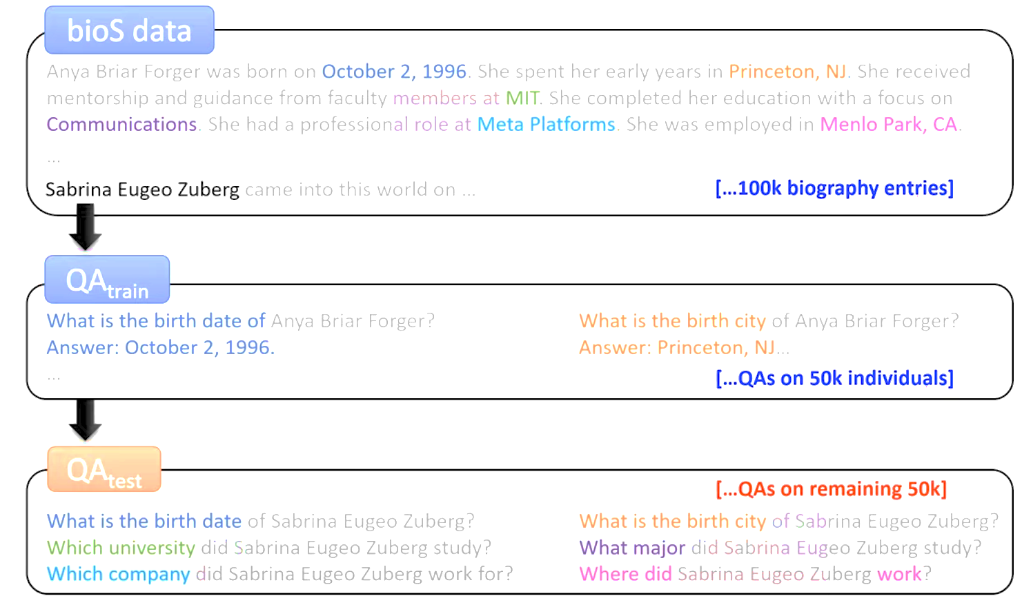
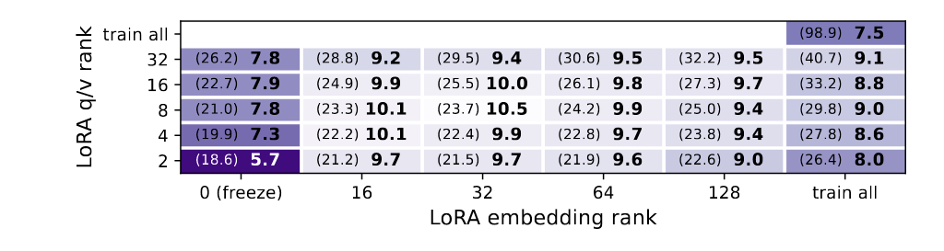
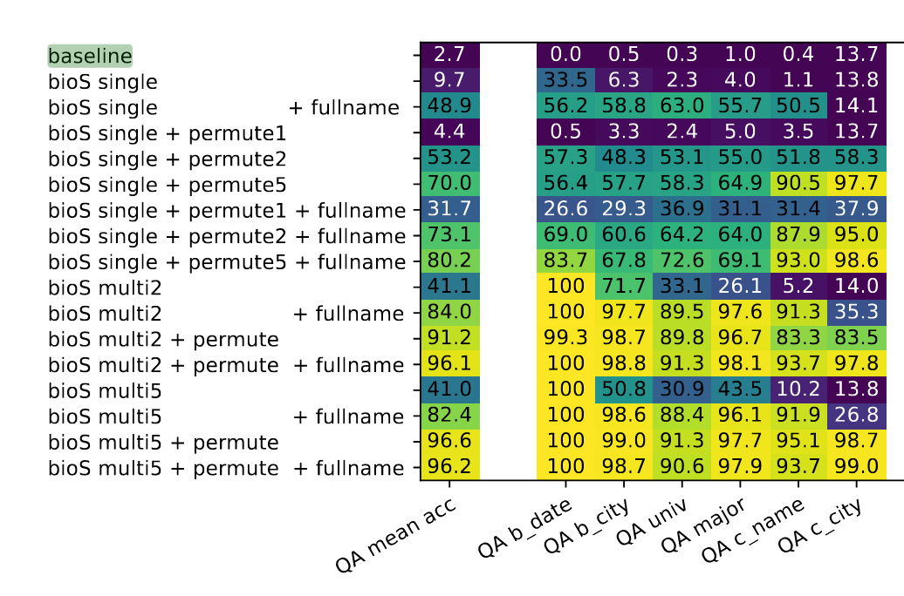
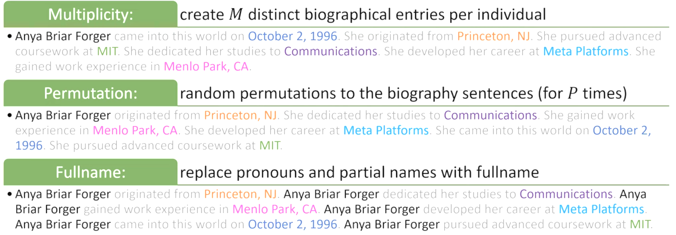
Knowledge Storage & Extraction
Pretrain on Bio and finetune with QA pairs
Two-stage training: pretrain first and finetune
Findings
LMs fail to answer out-of-domain questions (regarding any model size and finetuning method).
Data augmentation in pretraining helps in knowledge storage (knowledge must be stored in different ways)
Data augmentation techniques
[1] Physics of Language Models: Part 3.1, Knowledge Storage and Extraction. Arxiv
Notes:
因为我们只在pretrain的阶段做了augmentation，而并没有对QA的数据做instruction 的augmentation。所以这个结果说明，用不同的格式来存这些知识，可以让这些知识更加容易提取。

Slide 20
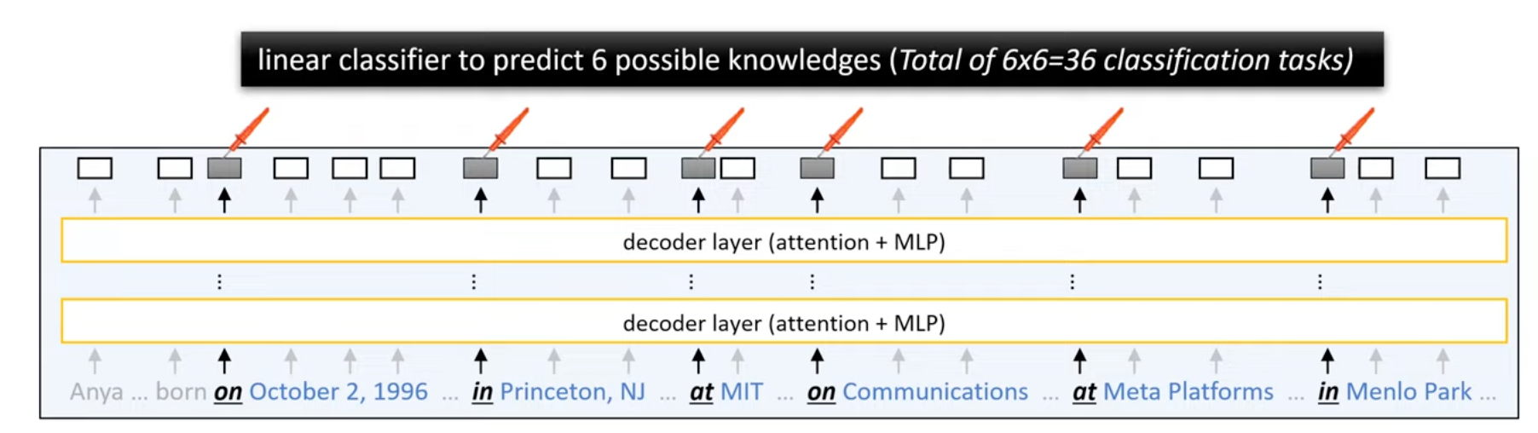
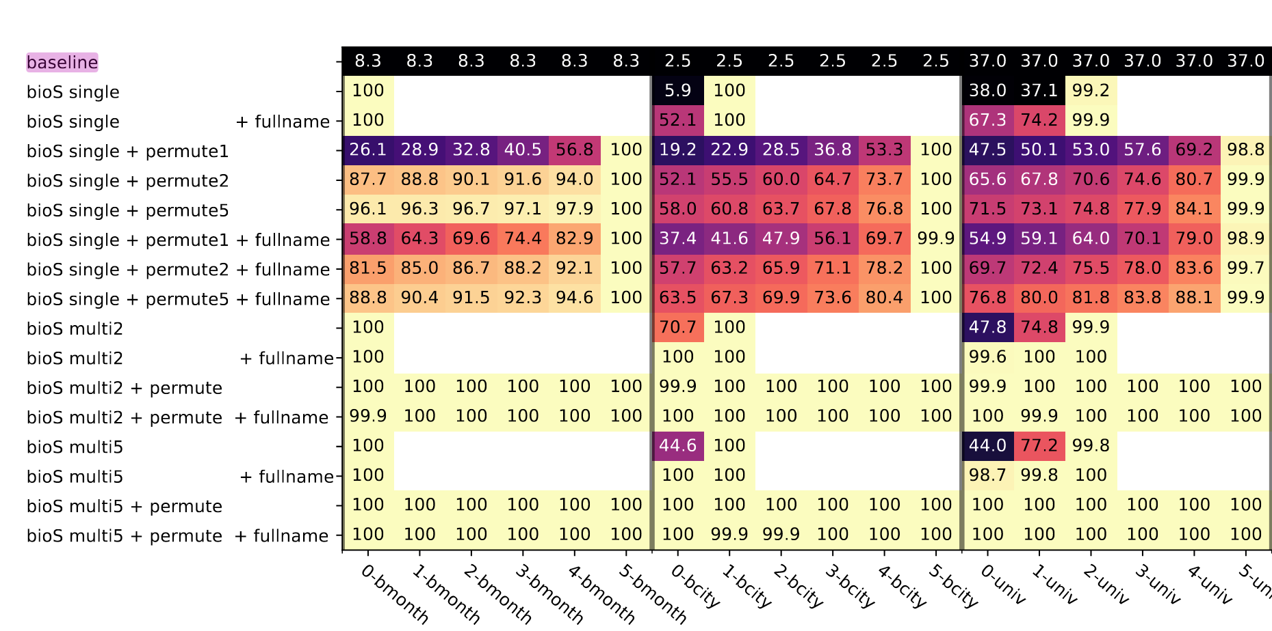
Knowledge Storage & Extraction
How does transformer store the knowledge?
Hypothesis: the knowledge may be encoded in some place in advance.
Position-based probing
Data augmentation helps!
Probing at the token before attributes.
Augmentation helps in learning the right logic: it is Anya who works in Meta,
rather than someone born on October 2, 1996 works in Meta.
[1] Physics of Language Models: Part 3.1, Knowledge Storage and Extraction. Arxiv
Notes:
想象一下没有permute之前的，可能只是学到了

Slide 21
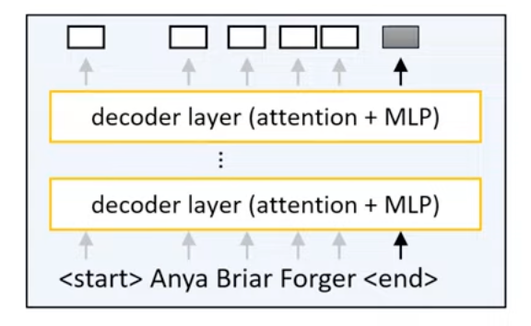
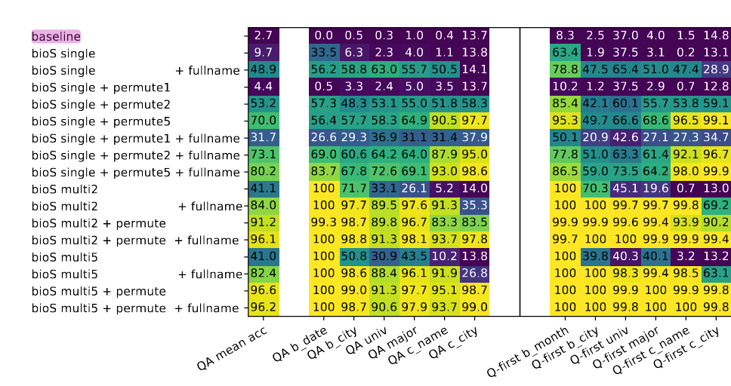
Knowledge Storage & Extraction
How does transformer store the knowledge?
Probing attributes
Hypothesis: the knowledge may be encoded in the name of the person.
Query-based probing
A similar pattern with QA accuracy
-> “attribute directly saved to the person’s name” (during pretraining) is crucial for knowledge extraction.
Probing at the last token for the full name.
QA acc
Probing acc
[1] Physics of Language Models: Part 3.1, Knowledge Storage and Extraction. Arxiv
Notes:
想象一下没有permute之前的，可能只是学到了

Slide 22
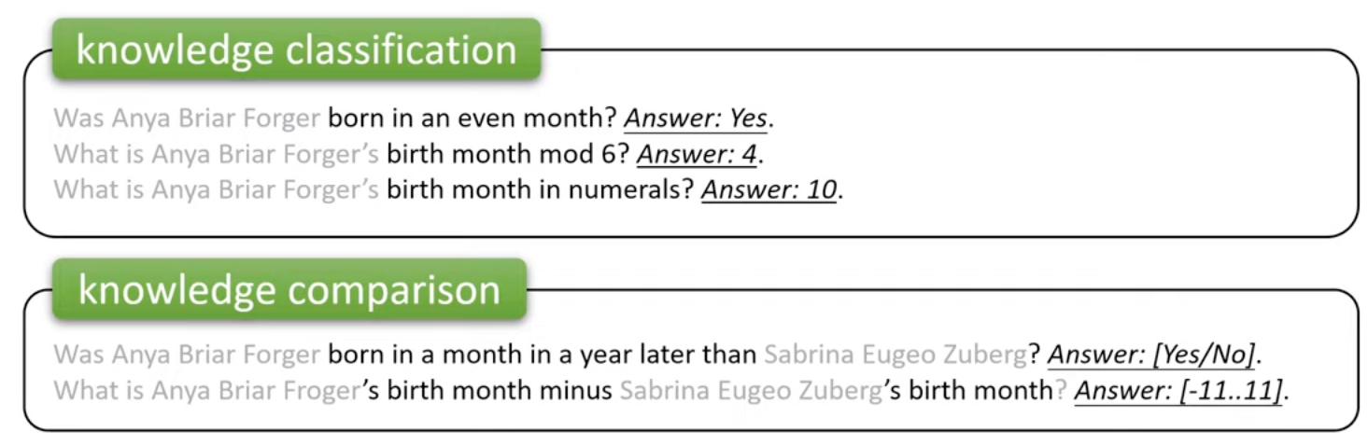
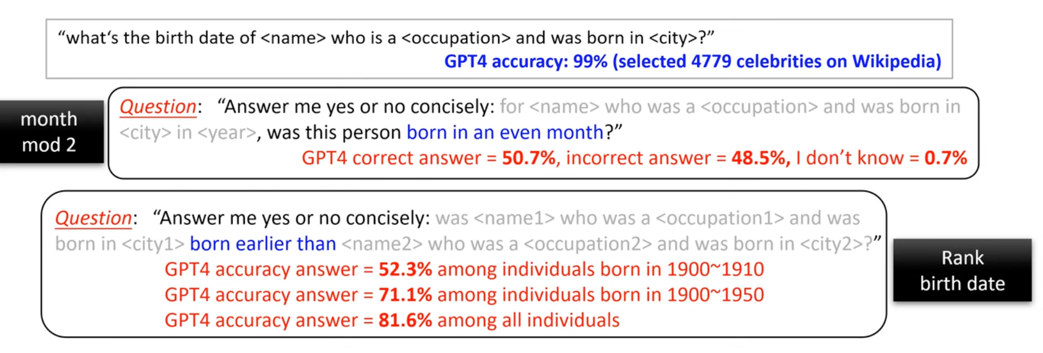
Knowledge Manipulation
Can LMs connect learned knowledge with other concepts?
GPT-4 still suffers!
Knowledge manipulation is hard
[1] Physics of Language Models: Part 3.2, Knowledge Manipulation. Arxiv

Slide 23
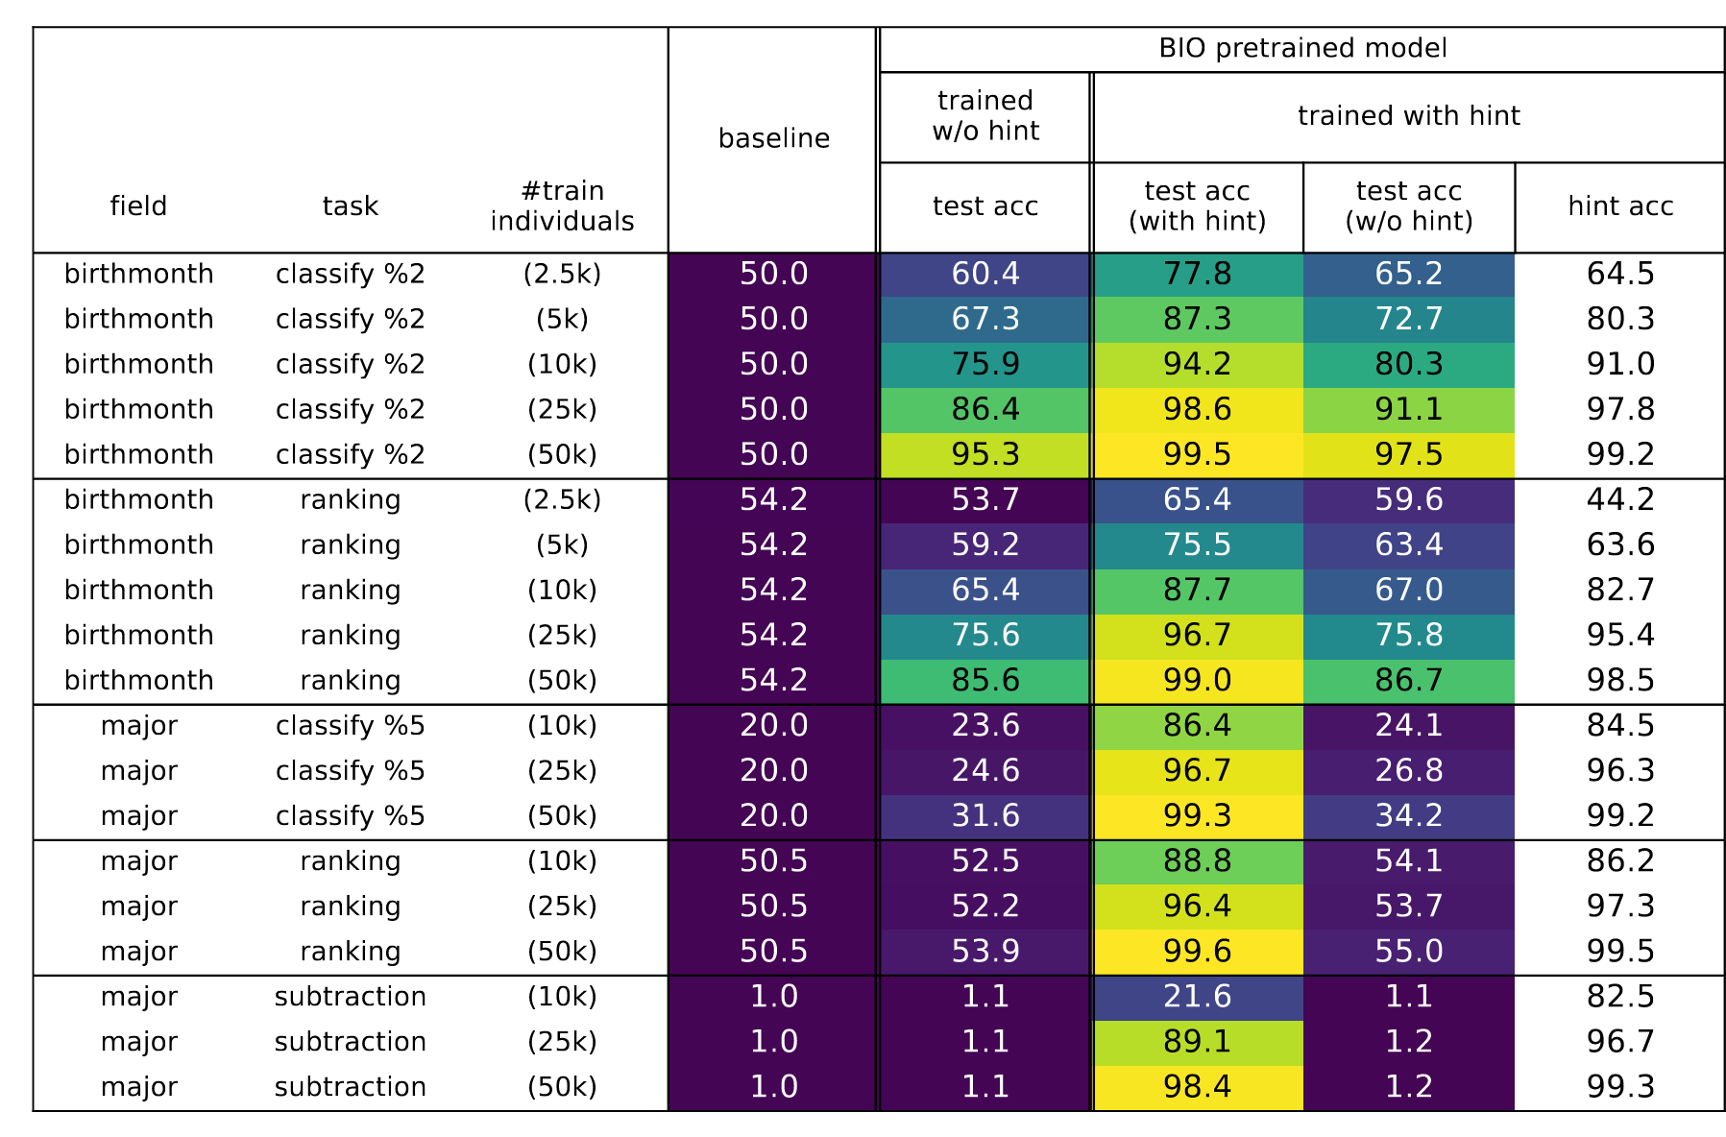
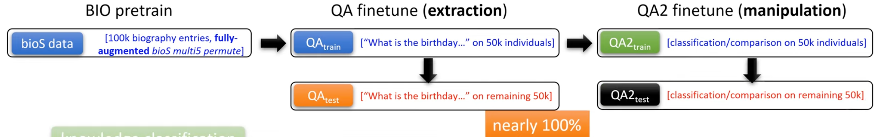
Knowledge Manipulation
Can LMs connect learned knowledge with other concepts
Finetuning a knowledge-aware LM on manipulation tasks.
LMs suffer from knowledge manipulation although they can store and extract knowledge perfectly.
Chain of thought helps in knowledge manipulation.
Required in both training and inference.
[1] Physics of Language Models: Part 3.2, Knowledge Manipulation. Arxiv

Slide 24
Knowledge
Summary
Findings 1: Mixed training & data augmentation help in knowledge storage.
Findings 2: Knowledge must be stored in the pretraining stage.
Findings 3: Correct knowledge storage position (i.e., name) is the key for extraction.
Findings 4: Knowledge manipulation is hard, while CoT helps.
[1] Physics of Language Models: Part 2.1, Grade-School Math and the Hidden Reasoning Process. Arxiv

Slide 25
Intelligence in language models:
Reasoning & Task Solving
Knowledge
Grammar

Slide 26
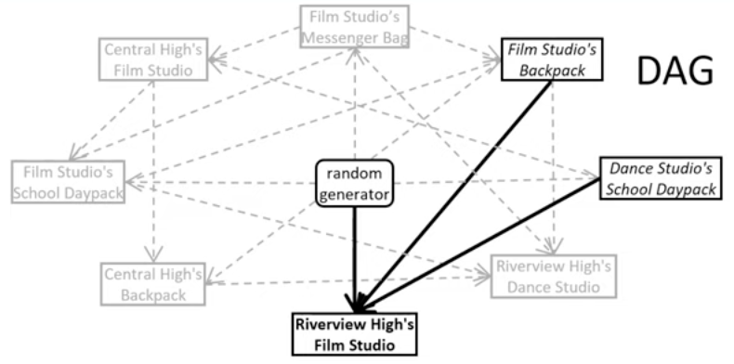
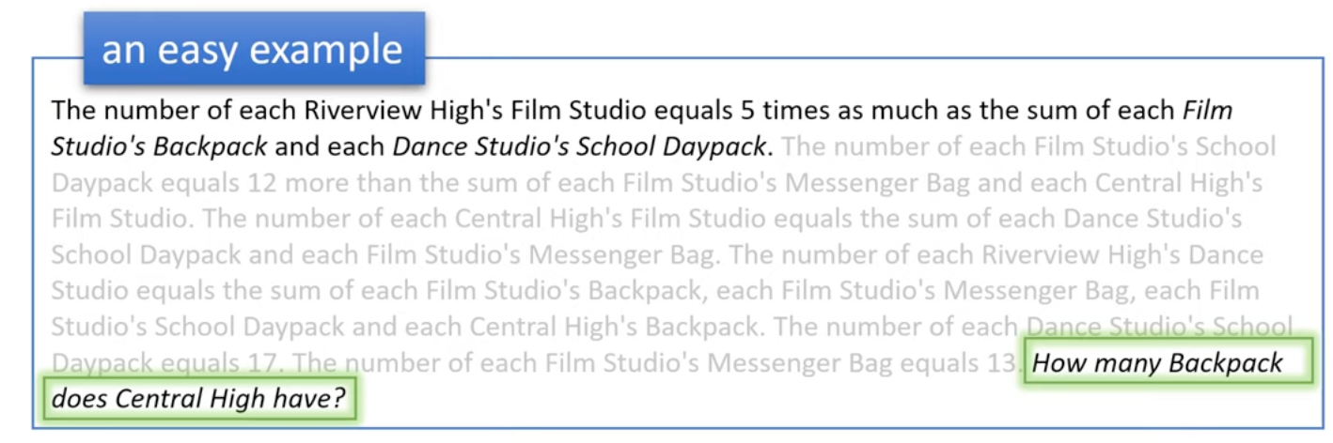
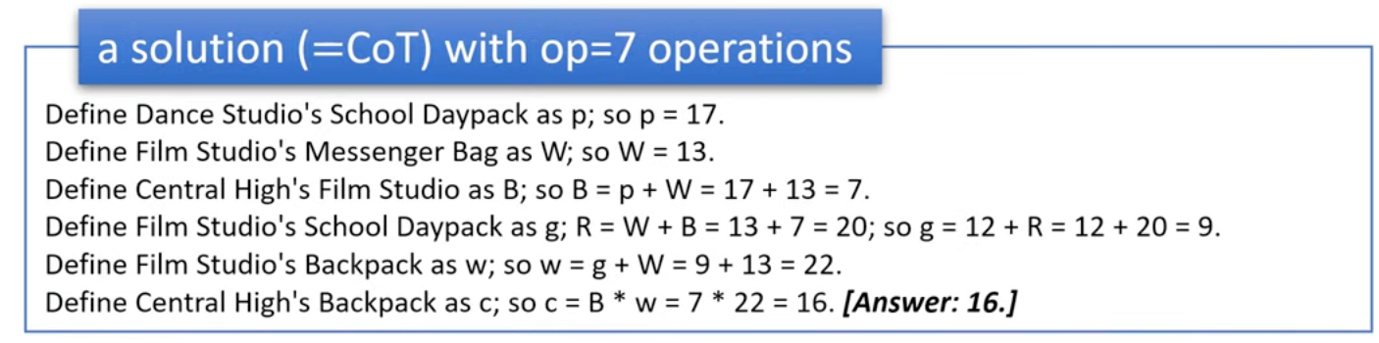
Reasoning & Task Solving
Synthetic graduate-school math datasets: iGSM
GSM8k is too small and may contain data contamination.
Sampling
Key features:
Infinite.
No common sense.
Pure logic.
Difficulty control
[1] Physics of Language Models: Part 2.1, Grade-School Math and the Hidden Reasoning Process. Arxiv
Notes:
Diversity: not only memorize the small part of CFGs

Slide 27
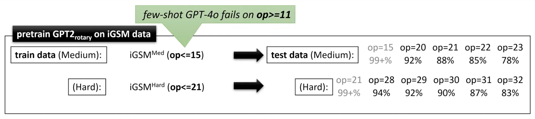
Reasoning & Task Solving
Training on iGSM
Findings
Transformer can generalize on unseen data (reasoning length generalization).
Few-show GPT-4o fails on medium-level tasks.
Transformer can learn generalized reasoning abilities from limited data
[1] Physics of Language Models: Part 2.1, Grade-School Math and the Hidden Reasoning Process. Arxiv
Notes:
LM可以学会如何解决问题，而不是死记硬背

Slide 28
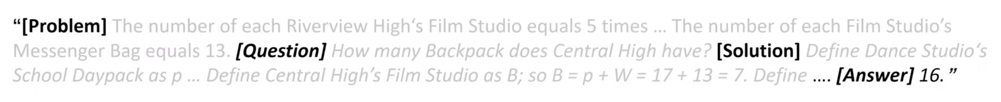
Reasoning & Task Solving
The mental process of LMs
Hypothesis: LMs know what to compute before generation.
Probing
nece(A): is A necessary for this problem?
can_next(A): can A be computed next?
dep(A, B): does A depend on B?
LMs know！
99% accuracy for three tasks
Probing nece(A)
Probing dep(A, B)
Probing can_next(A)
[1] Physics of Language Models: Part 2.1, Grade-School Math and the Hidden Reasoning Process. Arxiv

Slide 29
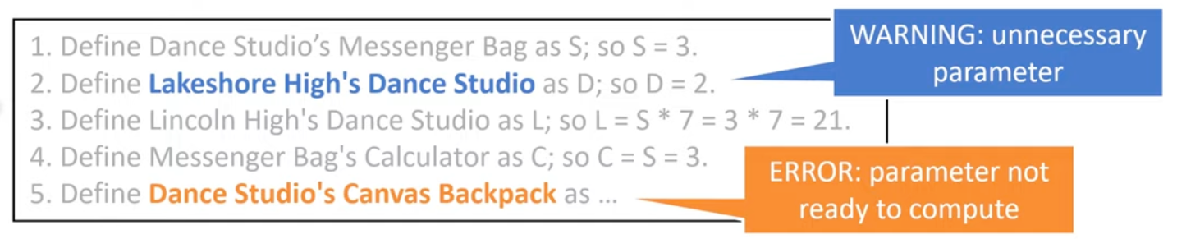
Reasoning & Task Solving
LMs may make mistakes
for
Generating unnecessary parameters
Hallucinating parameters not ready to compute
nece(A) -> 1
Hidden states guide the next action for transformers.
can_next(A) -> 1
[1] Physics of Language Models: Part 2.1, Grade-School Math and the Hidden Reasoning Process. Arxiv

Slide 30
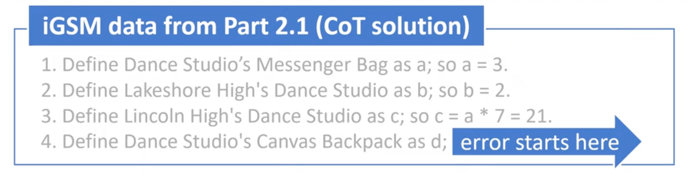
Reasoning & Task Solving
Do LMs know their mistakes?
Binary probing: is this a mistake?
Yes！
High probing accuracy!
[1] Physics of Language Models: Part 2.1, Grade-School Math and the Hidden Reasoning Process. Arxiv

Slide 31
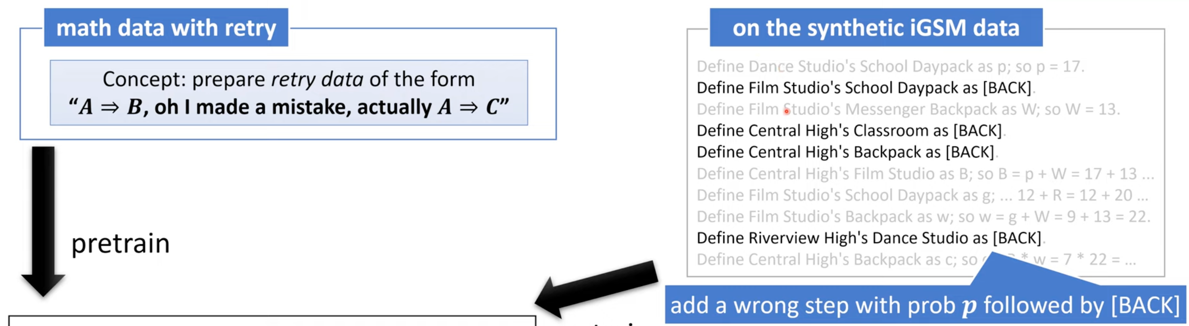
Reasoning & Task Solving
Mistake correction
Can we correct the error once it happens?
Retry once making mistakes
Retry works!
w/o Retry: 0.78 -> w Retry: 0.94
[1] Physics of Language Models: Part 2.1, Grade-School Math and the Hidden Reasoning Process. Arxiv

Slide 32
Reasoning & Task Solving
Summary
Findings 1: Transformer can learn generalized reasoning abilities from limited data.
Findings 2: LMs know it is making mistakes.
Findings 3: Pretraining with error-correction data -> acc boost.
[1] Physics of Language Models: Part 2.1, Grade-School Math and the Hidden Reasoning Process. Arxiv

Slide 33


Physics of LMs in Recommendation
In recommendation, LMs can
Generate recommendations via SFT
Provide excellent features for recommenders
LMs as recommender
LMs as feature encoder
Hypothesis: LMs understand recommendation in their hidden states.
[1] Language Representations Can be What Recommenders Need: Findings and Potentials. Arxiv

Slide 34





Physics of LMs in Recommendation
Verification: linear mapping
Linearly map language representations into another space for recommendation
Homomorphism between language and recommendation spaces!
Effective
Robust
Scaling
[1] Language Representations Can be What Recommenders Need: Findings and Potentials. Arxiv

Slide 35
Physics of Language Models
Reasoning & Task Solving
Q & A
Knowledge
Sheng Leheng (盛乐恒)
2025.1.22
Grammar
https://physics.allen-zhu.com/
Notes:
2

